Slide 1

School Holidays
A Social Story

Slide 2
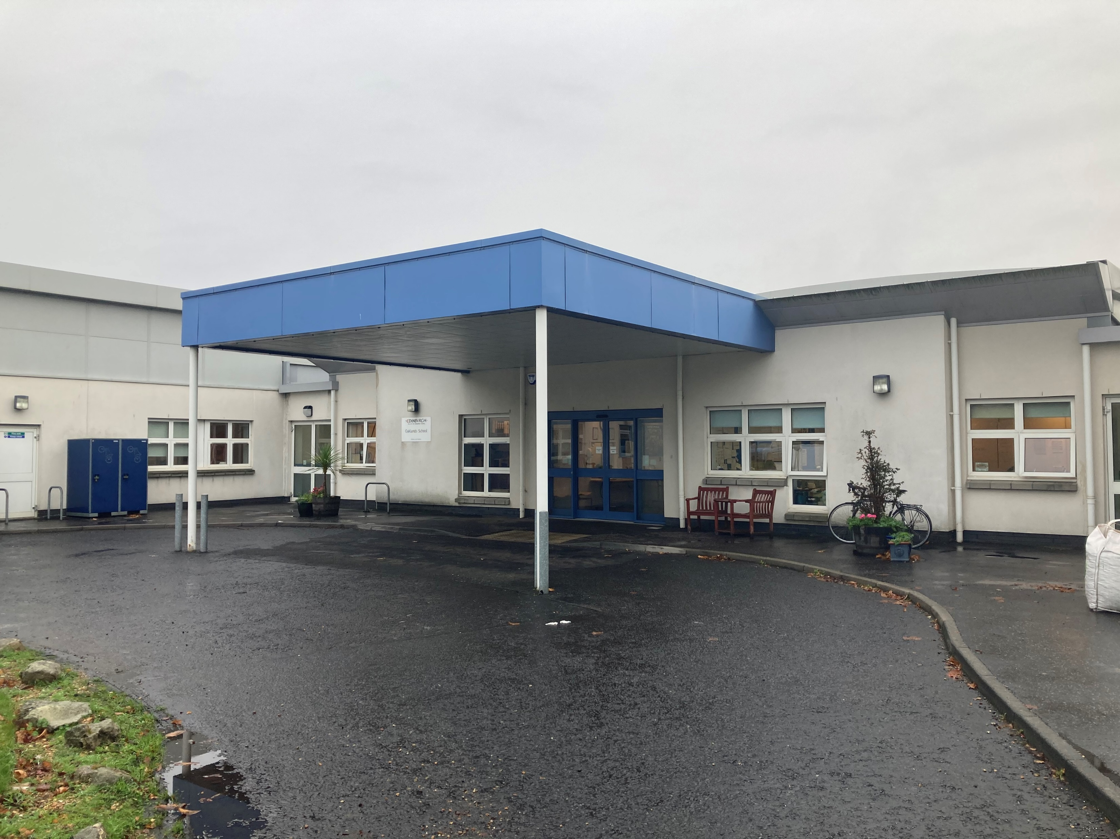
During the week I go to school.

Slide 3
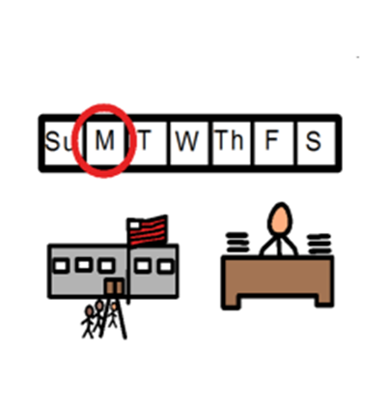
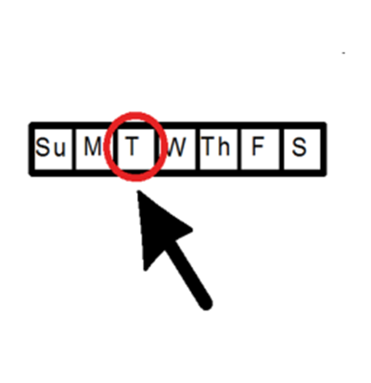
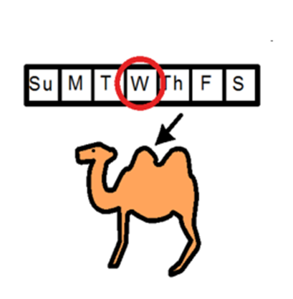
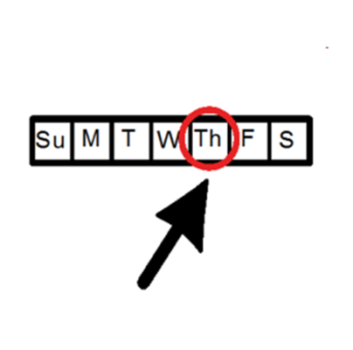
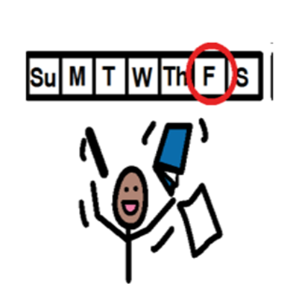
These are the days that I go to school.

Slide 4
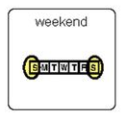

There is no school at the weekend.

Slide 5
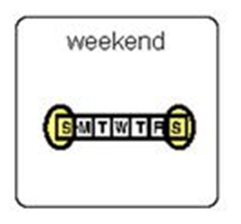
At the weekend I do fun things.
(draw or stick on a picture of something you do at the weekend)

Slide 6

After the weekend, I go back to school. My teacher is pleased to see me.

Slide 7

Soon it will be the school holiday.

Slide 8
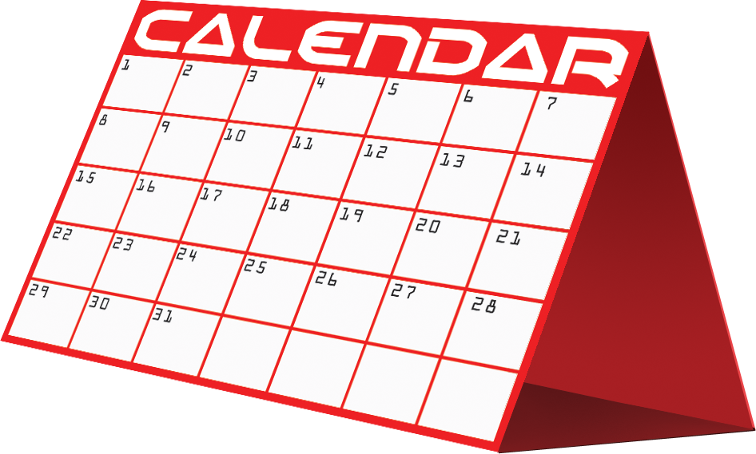
I can use a calendar to count the days until the holiday.

Slide 9


There is no school during the holidays.

Slide 10
In the holidays I do lots of fun things.
(draw or stick some pictures of things you will do or people you will see in the holidays)

Slide 11
I can also use a calendar to count the days until I go back to school.

Slide 12

After the holidays I go back to school.

Slide 13

My teacher is very pleased to see me.

Slide 14
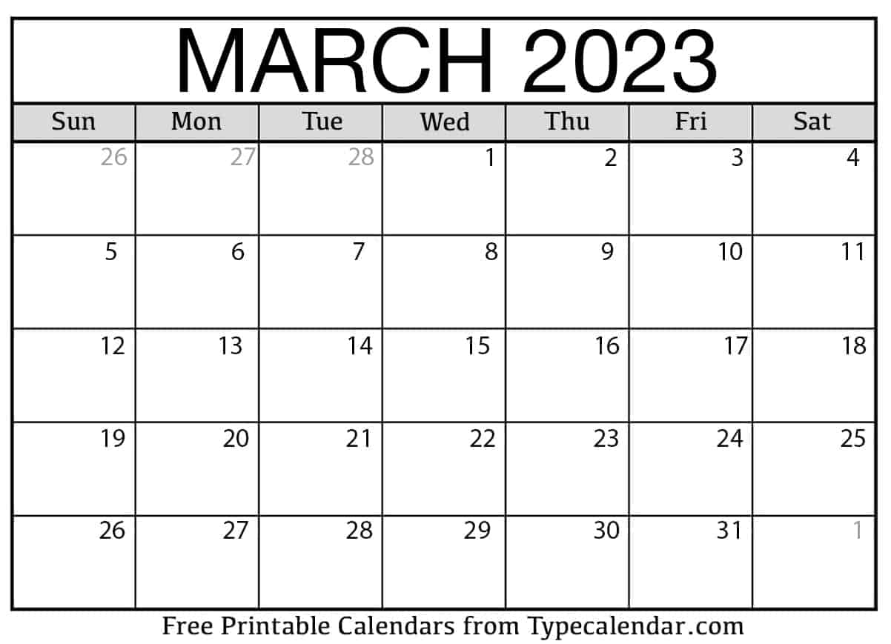


Slide 15
