Slide 1
SPACE

Slide 2
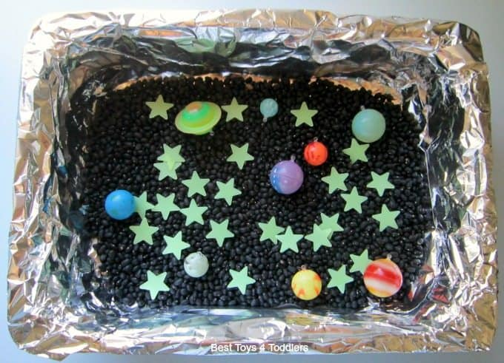
SENSORY SPACE PLAY
Cover trays with tin foil and then fill trays with black peas or similar, to represent space. Use brightly coloured bouncy balls to represent planets and glow in the dark stars. Help pupils find items. “Find me a star,” or “find me a small ball,” or “find one the same,” type questions can be used.

Slide 3


MATCHING CARDS
Create 2 sets of pictures linked to a space theme. Make the pictures quite different eg a planet, a star, a rocket, an alien and a spaceman. Print out at a size appropriate to your pupils and laminate. Use for simple 1:1 matching, or vocab work (“Give me the rocket.”) Use to make choices etc.

Slide 4
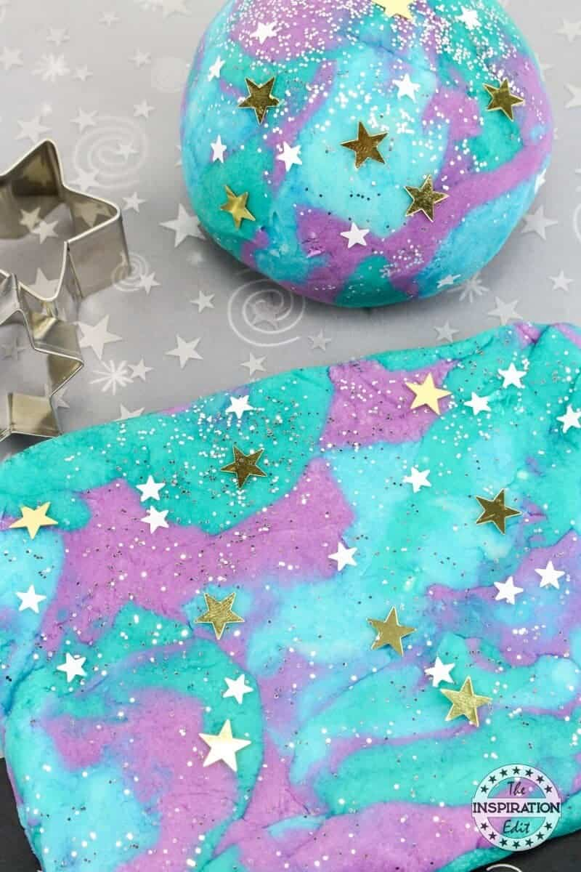
SPACE PLAY DOUGH
To make the dough use 3 cups of water, 3 cups of flour, 1.5 cups of salt, 3 tbsp of veg oil, 3 tsp of cream of tartar. Mix together over a low heat until it clumps together. Break into 3 pieces and colour with blue, pink and yellow colouring (wear gloves if you want). Mix in some tiny edible sugar stars or silver balls. Now it is ready to play with. Roll, squish, cut etc.

Slide 5
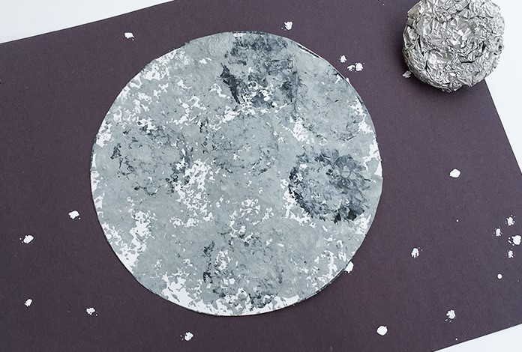
FOIL PRINTED MOON SURFACE
Cut a large white circle from paper. Shape some foil into balls and press one side flat. Mix up different shades of grey, dip the foil into them and use to stamp/print over the circle. Using different shades will allow you to build up a cratered moon surface effect. Once dry mount on a black background with little white stars printed on with white paint.

Slide 6
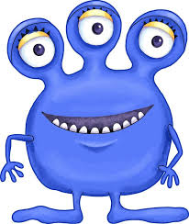
SOLAR SYSTEM STRETCHES
Reaching high up to the sky
Wave to spacemen flying by
Planets orbit side to side
Here come aliens! Time to hide!
Reach up with the pupils – if they can independently do so encourage that. Wave next. Then move arms/bodies from side to side. Finally use a cloth/scarf to cover heads.

Slide 7

GOING TO SPACE SONG
To tune of This Old Man.
Going to space,
Going to space,
Holly Class are going to space,
What will we find when we reach that distant place?
Holly Class are going to space
10, 9, 8, 7, 6 etc
To tune of You Cannae Shove Your Granny
We found aliens, aliens, aliens out in space
We found aliens, aliens, aliens out in space
We found aliens, aliens, aliens,
Aliens, aliens, aliens,
Aliens, aliens, aliens out in space
change as required
Sing through the verse and after the countdown allow a pupil to choose a picture of something from space – alien, satellite, space junk, craters etc.
Sing the second verse.
Repeat so that everyone has a turn.

Slide 8
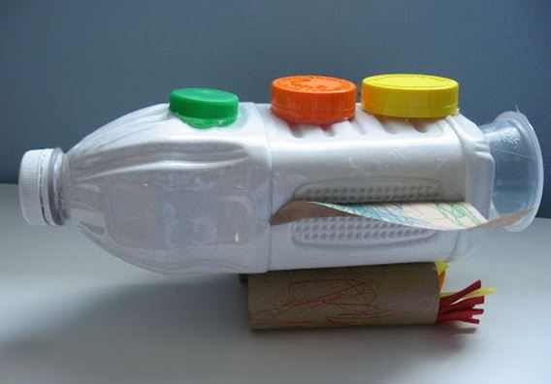
JUNK MODEL ROCKET
Paint a plastic bottle white (mixing pva into paint will help it stick).
Add wings from painted cardboard.
Make boosters from painted loo rolls and bright flame coloured tissue.
Add bright bottle tops and a small plastic pot.
Allow pupils to undertake as much as possible – painting elements with brushes or sponges, spreading glue, making choices about colours etc.

Slide 9
SPACE GAMES
Corners – play like normal Corners but use pictures of space items.
Alien Dash – make a home area. One person is the alien chaser (they could wear a hat or badge). Everyone moves around the space until the music stops when the alien chaser will try to catch them as they run back to the home area – you could use a ball like dodgeball to hit them with if easier.
Hot Moon Rock -Everyone sits in a circle and passes the hot moon rock from one person to the next (while music is playing). Someone calls time or stops the music and the person left holding the moon rock is out. Continue until there is only one person left. You can use one of those therapeutic pillows that you warm up in the microwave, roll it into a ball and put a small blanket to wrap it up, that way it will really be a hot moon rock (not too hot of course).

Slide 10
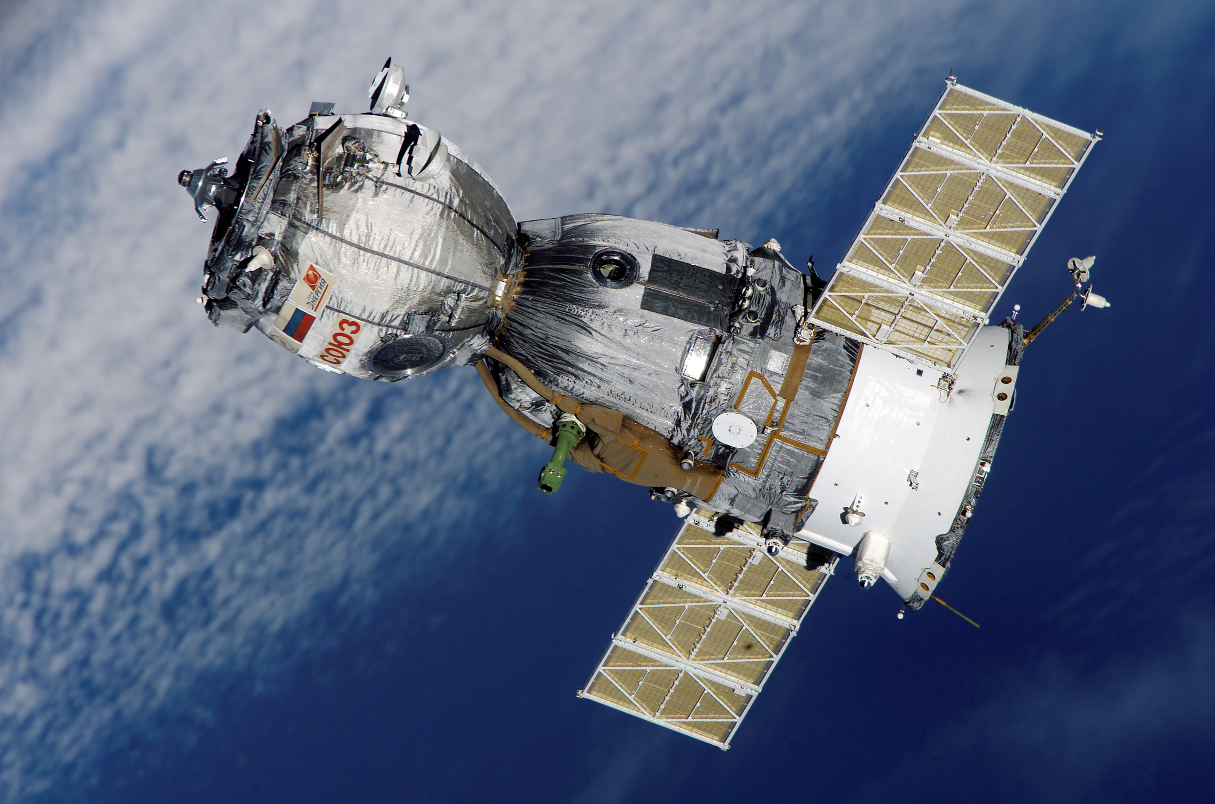
SPACE SCAVENGER HUNT
Put pictures of space themed items into the woods or playground. If you put multiples of each picture then each pupil could have a different item to hunt down eg find 5 pictures of rockets.
Take the pupils out. When they find a matching picture they could ring bells or bang a drum.

Slide 11
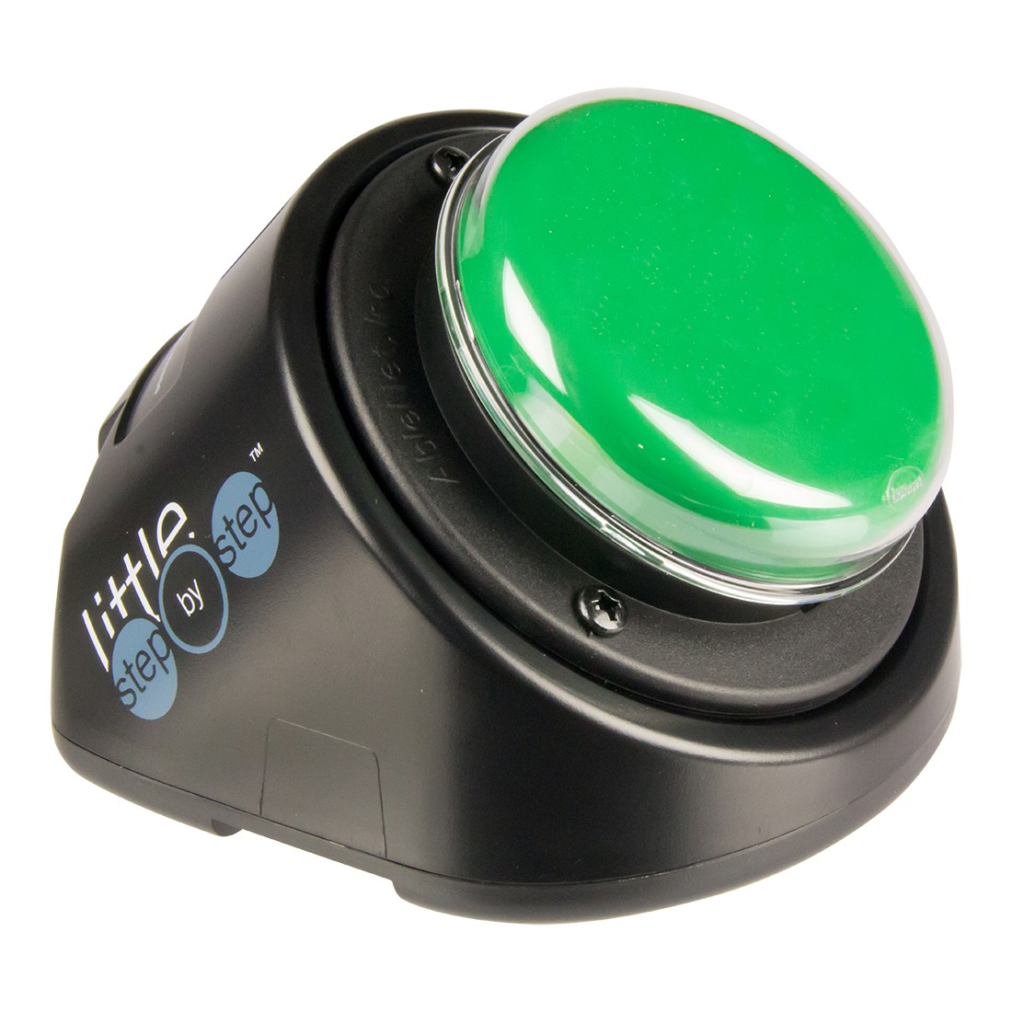
SPACE SINGALONG
Record a song such as Zoom, Zoom, Zoom onto a Step by Step making a break after each line.
Let pupils sing the song by pressing the Step by Step. They could sing the whole song or each take a line and pass the Step by Step on.
Good opportunities to practice core words again, like, go.

Slide 12

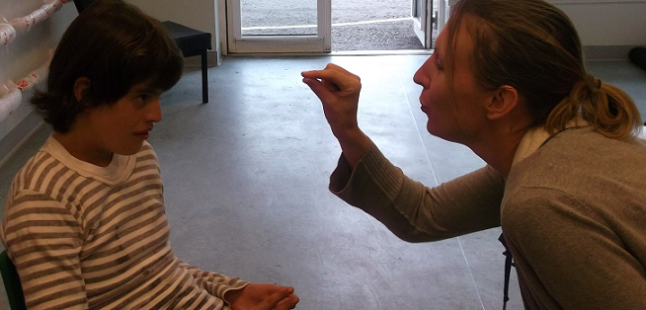
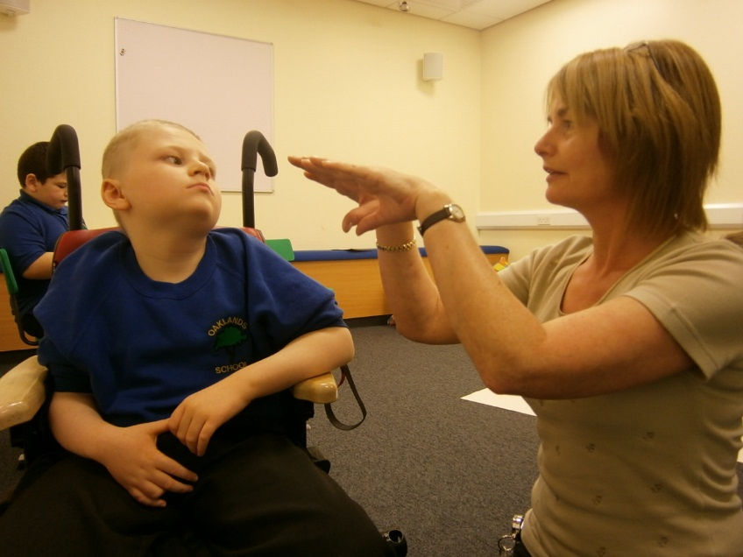
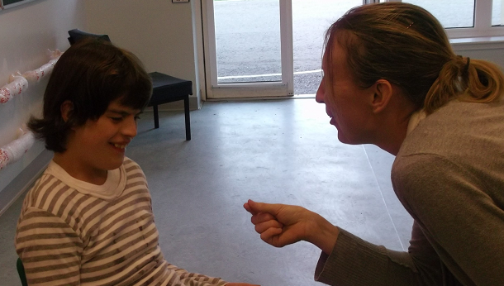
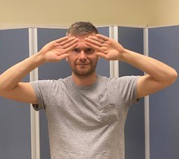
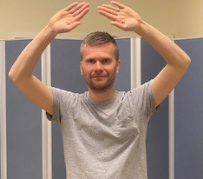
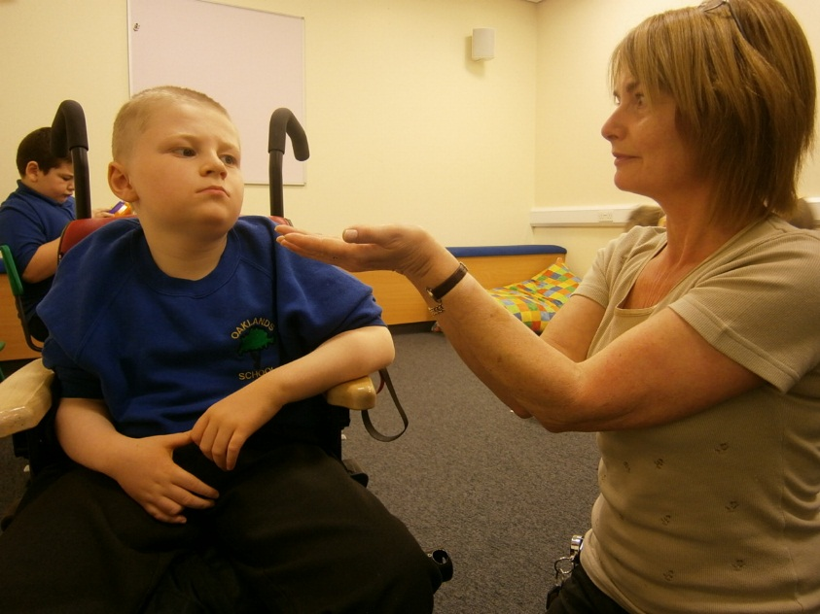
SIGNALONG SIGNS FOR OUR SPACE THEME
Moon
Working hand, extended index and thumb together (palm forward, pointing up), twists down in outward crescent shape, finger and thumb opening and closing.
Space
Flat hands (palms fprward, pointing in.up) above forehead make large vertical inward circle
Planet
Open hands (palms down, pointing forward) circle round to finish palms up as though tracing shape of globe

Slide 13
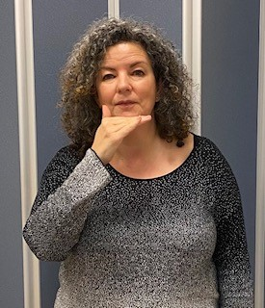
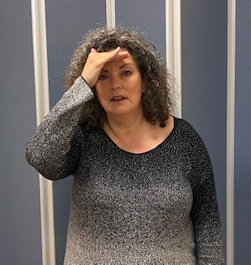
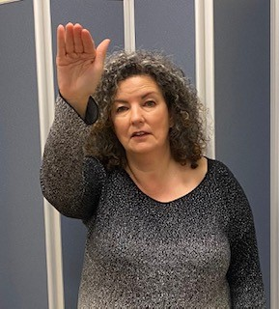
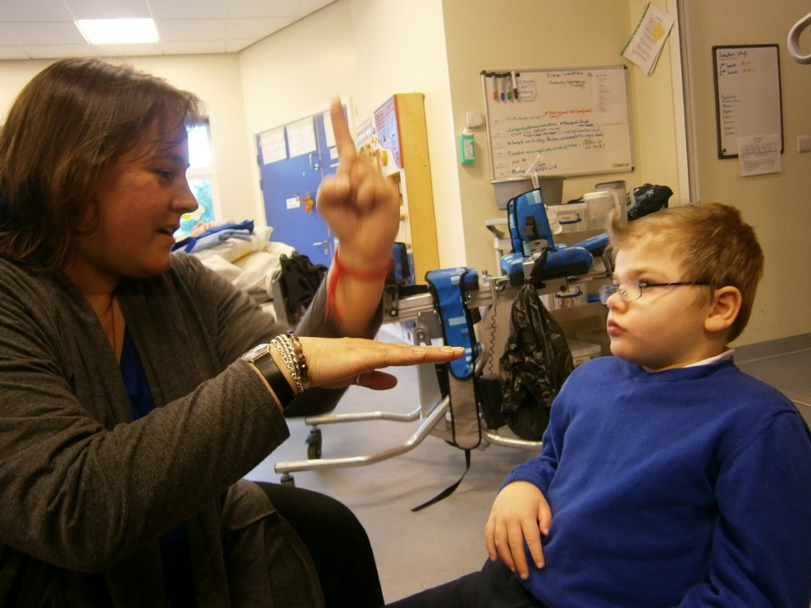
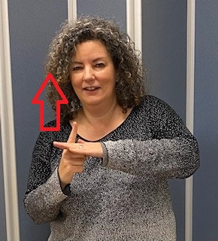
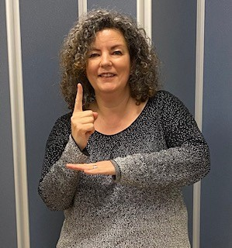
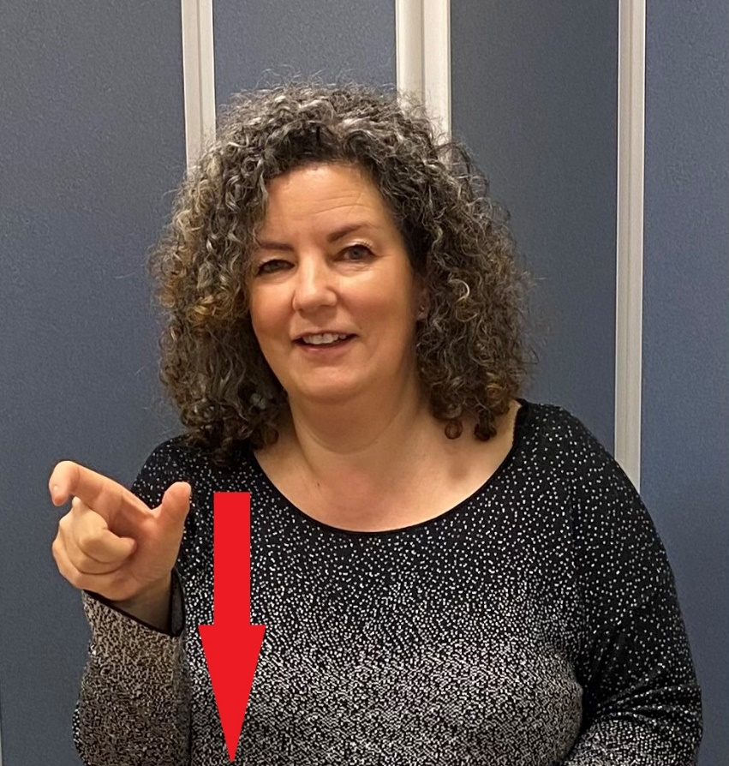
Rocket
Working index hand (palm in, pointing up) behind and touching supporting flat hand (palm down, pointing in); working hand moves up
Alien
Working bent hand (palm in, pointing up) held in front of chin, touches chin and moves up to touch forehead; then hand moves forward/up to finish palm facing forward.
Astronaut (= rocket + person)
Working index hand (palm in, pointing up) behind and touching supporting flat hand (palm down, pointing in); working hand moves up; then working "C" hand (palm forward, pointing out) moves down in front of body

