Slide 1
Space Rap
You can share this story rhyme with your child. If you have a drum (or empty Quality Street/Celebrations/Miniature Heroes -any chocolate of choice tub) you could allow/help them to bang out the rhythm. Or tap on an arm/leg/tummy etc

Slide 2
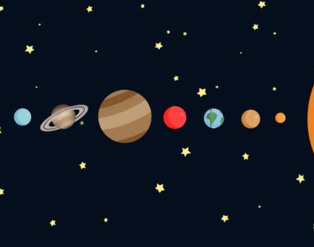
Mercury, Venus, Earth and Mars, Jupiter, Saturn, Uranus and Neptune.
On a rocket I travelled to the stars,
On a rocket I travelled to the stars,
On a rocket I travelled to the stars,
And this is what I saw….

Slide 3

I saw spaceships zooming through the sky,
And I gave them a wave as they passed by.
Yes I gave them a wave as they passed by.

Slide 4
Mercury, Venus, Earth and Mars, Jupiter, Saturn, Uranus and Neptune.
On a rocket I travelled to the stars,
On a rocket I travelled to the stars,
On a rocket I travelled to the stars,
And this is what I saw….

Slide 5

I saw an astronaut out for a little space walk,
We had to use our radios so we could have a talk!
Yes we had to use our radios so we could have a talk!

Slide 6
Mercury, Venus, Earth and Mars, Jupiter, Saturn, Uranus and Neptune.
On a rocket I travelled to the stars,
On a rocket I travelled to the stars,
On a rocket I travelled to the stars,
And this is what I saw….

Slide 7

I saw the moon and the stars shining ever so bright.
I am really, really lucky to have seen this special sight.
Yes I’m really, really lucky to have seen this special sight.

Slide 8
Mercury, Venus, Earth and Mars, Jupiter, Saturn, Uranus and Neptune.
On a rocket I travelled to the stars,
On a rocket I travelled to the stars,
On a rocket I travelled to the stars,
And this is what I saw….

Slide 9

I saw a flying saucer and it had the brightest shine.
And in it was an alien from a galaxy far from mine.
Yes in it was an alien from a galaxy far from mine.

Slide 10
Mercury, Venus, Earth and Mars, Jupiter, Saturn, Uranus and Neptune.
On a rocket I travelled to the stars,
On a rocket I travelled to the stars,
On a rocket I travelled to the stars,
And this is what I saw….

