Slide 1

A Winter Owl
We hope you enjoy this interactive story with your family. You could try listening to it first to give you some ideas and collect some of the resources we’ve suggested below..
Each element/ page has an associated sound/experience that you’ll hear and you could join in too:
The dark cave - make ‘owl hooting sounds’ –hoot through a cardboard tube eg kitchen roll or roll up some card/paper
  You could make an owl puppet cutting out the outline we’ve put on the next page – attach to string/wool and dangle from a stick or just use tape and attach to a ruler/pole and fly it up in the sky!
Stars – metal sounds tinkling, try using tea spoons or keys lightly jangling together.
Snow - bells – maybe you’ve got bells on a Christmas decoration, or tap a spoon or fingers on a metal pan lid
Ice – scrunch and shake foil or something crinkly like the inner packaging of a box of chocolate! Maybe have
a bowl with some ice cubes to handle/ feel too.
Snow Storm – hold a piece of paper /newspaper sheet and shake it - your child might be able to reach out and pat
it/move it too.
Winter trees - tap some wooden spoons together
Owlets – any squeaky toy/ball you can find would be good – jiggle/ shake together like the ‘little owlets’ bouncing
around.
You can still enjoy the story without using the suggestions we’ve added but it might make it even more fun sharing with your child and even more fun if the rest of the family wants to join in. Repeat the story regularly as your child may start to tune into it more.

Slide 2

Owl puppet shape

Slide 3
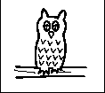

A Winter Owl
Owl

Slide 4

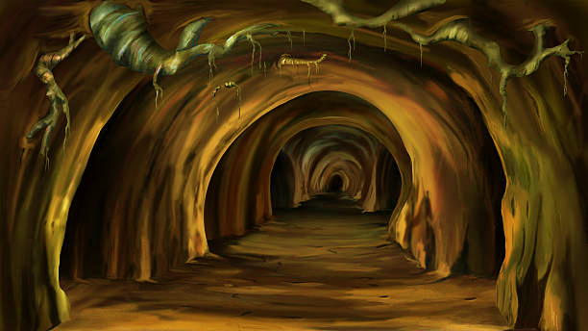
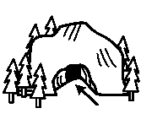
The Owl flies high
Through the dark, dark cave
The Owl flies high
Looking for her home
Cave

Slide 5



The Owl flies high
Through the shining stars
The Owl flies high
Looking for her home
Stars

Slide 6
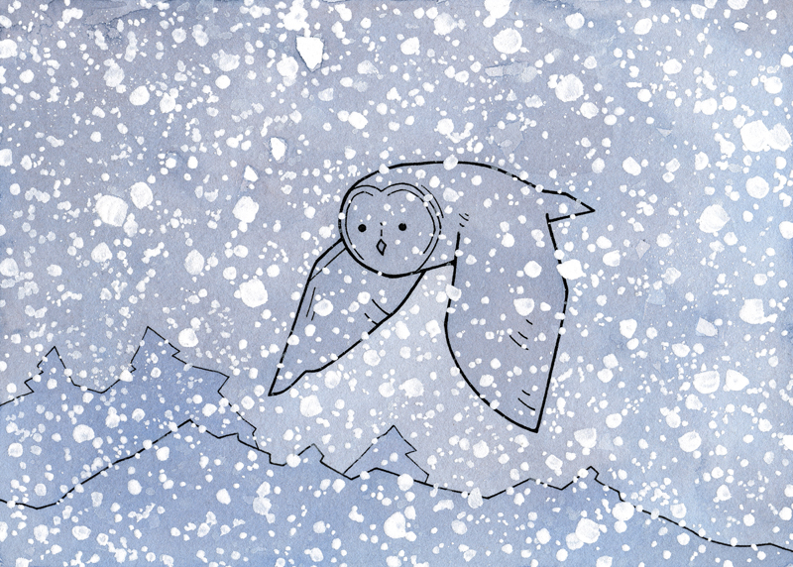

The Owl flies high
Through the falling snow
The Owl flies high
Looking for her home
Snow

Slide 7

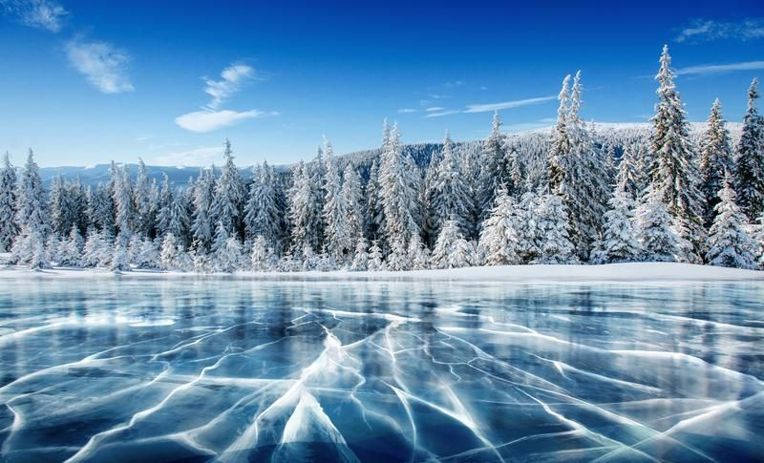

The Owl flies high
Through the frosty ice
The Owl flies high
Looking for her home
Ice

Slide 8

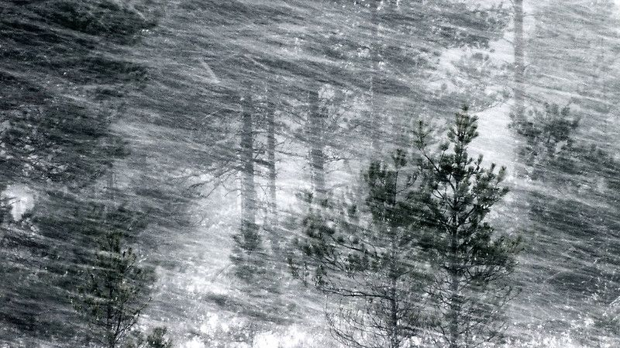
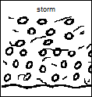
The Owl flies high
Through the raging storm
The Owl flies high
Looking for her home
Storm

Slide 9
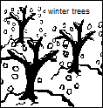
The Owl flies high
Through the winter trees
The Owl flies high
Looking for her home
Trees

Slide 10
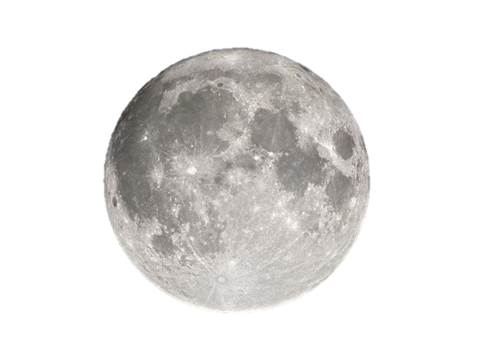
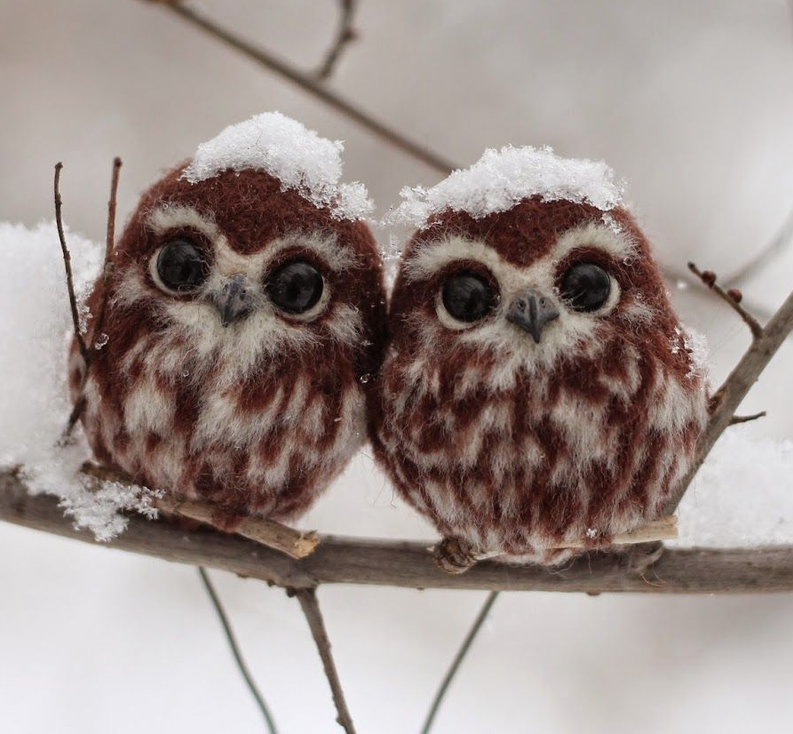

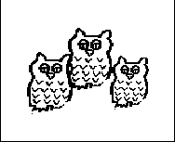
The Owl flies high
To find her family
The Owl flies high
Safely home at last
Owlets

Slide 11
A Winter Owl story is finished…

