Slide 1


OAKLANDS SCHOOL
Outdoor learning
…bringing outdoor learning inside!

Slide 2
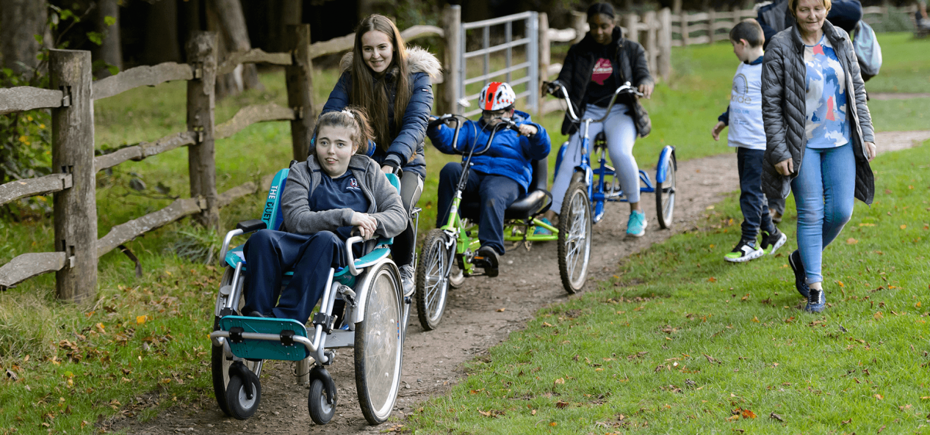
It’s outdoor learning week so we thought we’d put together some ideas for the family to enjoy together outside or inside.

Slide 3
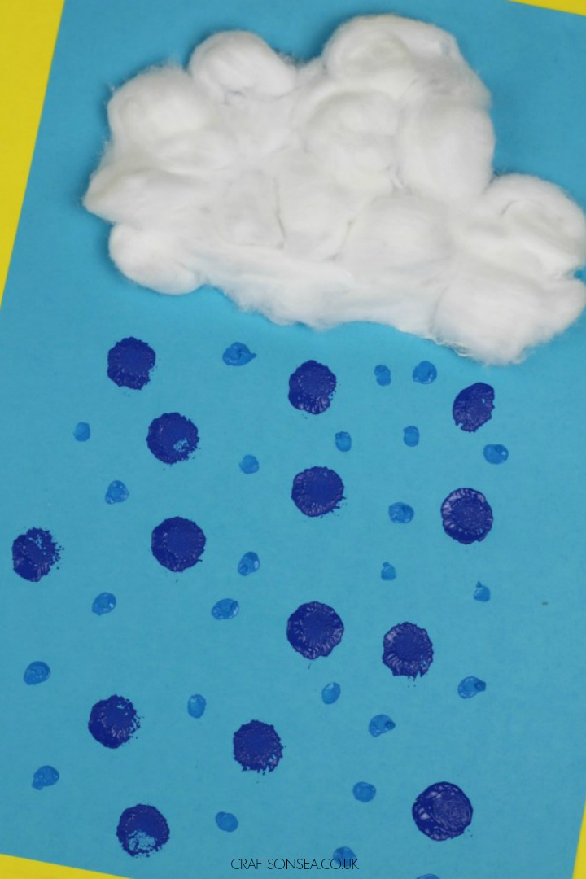
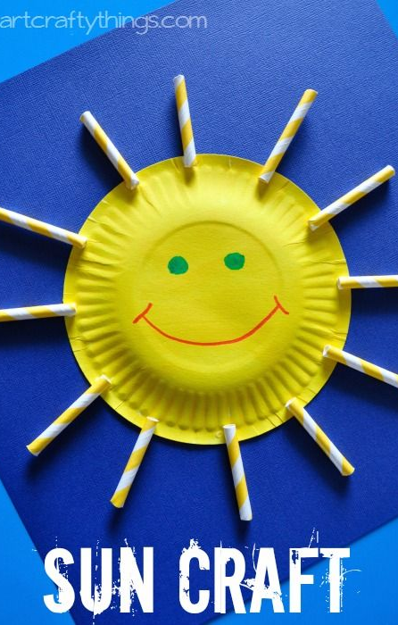
Use our Circle Time weather songs with props –
like fans for the wind,
or mirrors/torches to make sunshine, splashing water/sprays for rain, cotton wool for clouds.

Slide 4
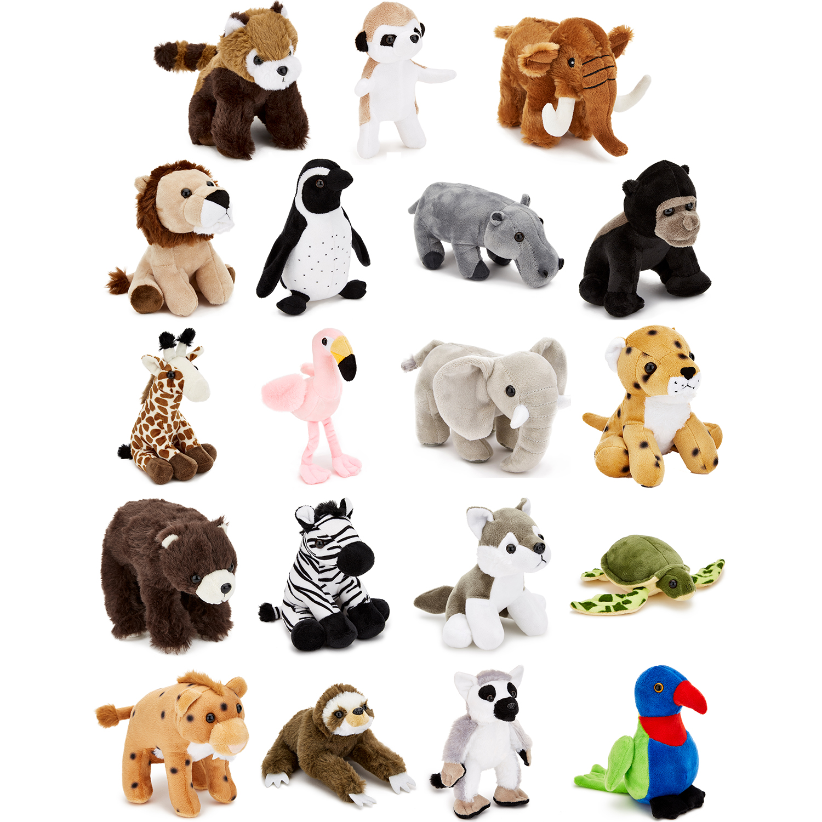
Share other nature/animal action songs to sing at home – help your child join in using soft toys/ puppets.

Slide 5


Get some props together for nature related sensory stories – Jasper’s Beanstalk is a lovely one.

Slide 6
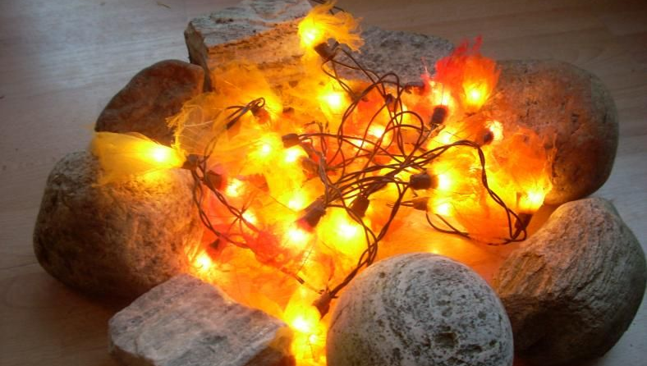
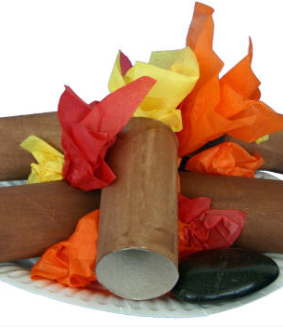
Have an indoor family campfire - build one in a box or similar using coloured paper. Sing a campfire song or even have a campfire type dinner around it.
Campfire songs like:
The Ants go marching 2 by 2
The bear went over the mountain
An Austrian went a yodelling
https://www.todaysparent.com/family/activities/campfire-songs-your-kids-will-love/

Slide 7
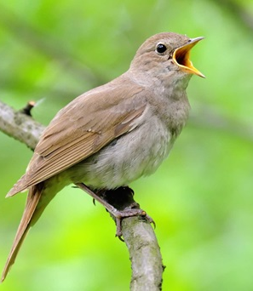
Listen to/watch nature recordings - bird song, forests etc.
    Relaxing sounds: https://www.youtube.com/watch?v=eKFTSSKCzWA
    Flying over Scotland: https://www.youtube.com/watch?v=_RTMLn7rDRw
    Spring watch live video cams: https://www.youtube.com/watch?v=ptvHeeVqbxg
    Edinburgh Zoo has different video cams. The meerkat one is cute: https://www.youtube.com/watch?v=rkux9EcyAF4

Slide 8
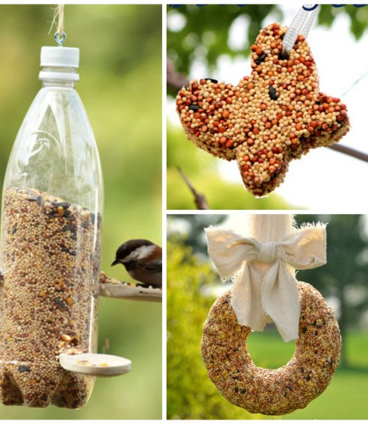
Make a bird feeder to hang from your window.
https://happyhooligans.ca/32-homemade-bird-feeders/
https://www.countryliving.com/diy-crafts/how-to/g3060/diy-bird-feeders/

Slide 9
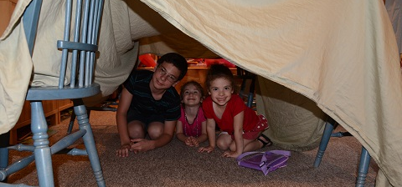
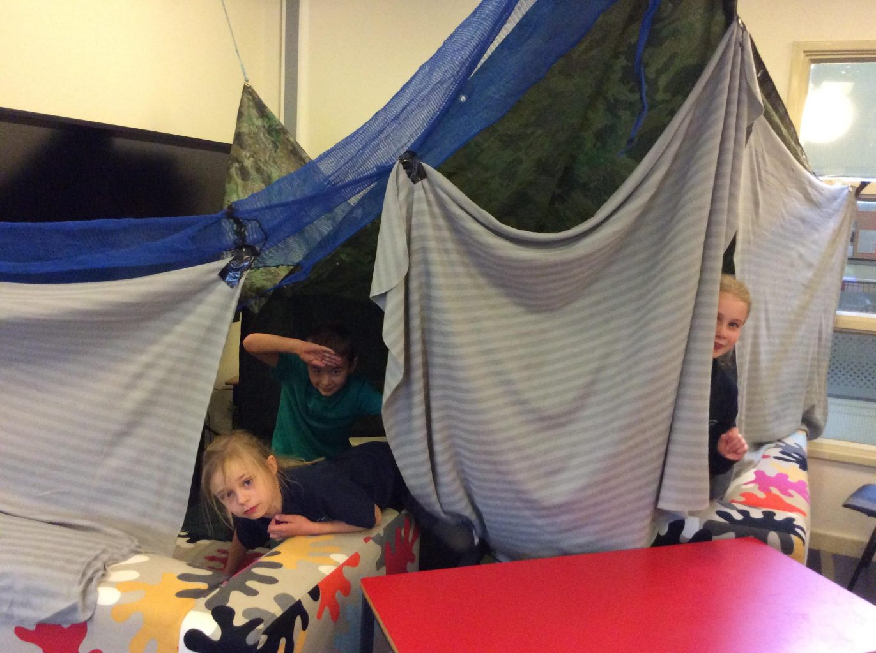
Make an indoor den, just a couple of cushions and a sheet can make a lovely space.
: https://www.pinterest.co.uk/savechildrenuk/den-day-lets-build-a-better-world/

Slide 10
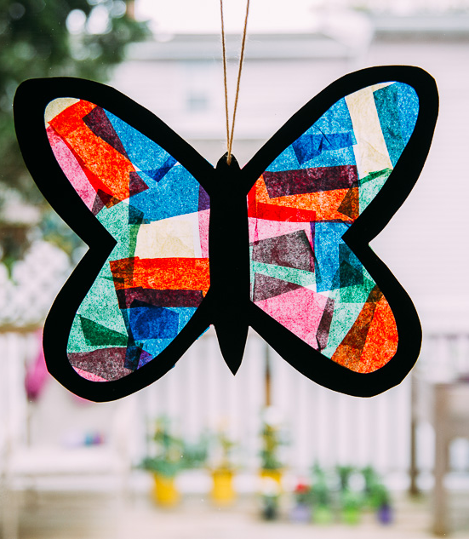
Make a stained-glass butterfly or other bug to stick on your window.

Slide 11
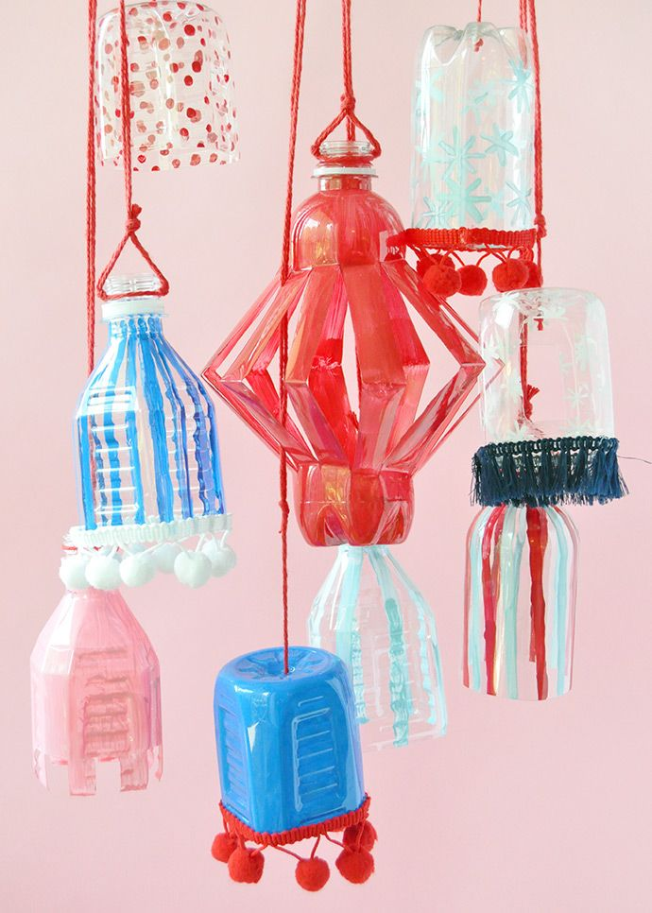
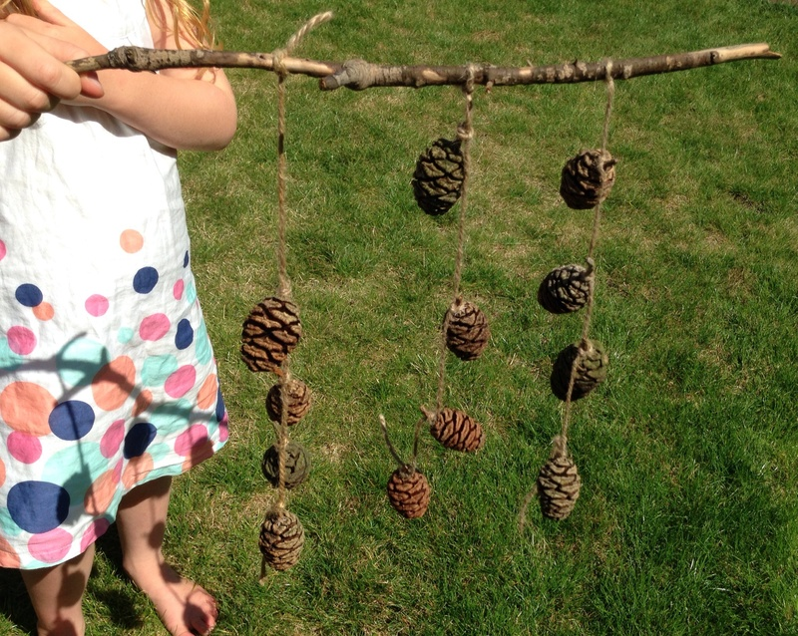
Make a nature mobile either with things found outside - leaves, sticks, feathers, or with cut outs of these e.g. butterflies, leaves etc. cut from milk cartons and coloured in or decorated with sweet wrappers.
Blow this with a fan and watch it move.

Slide 12
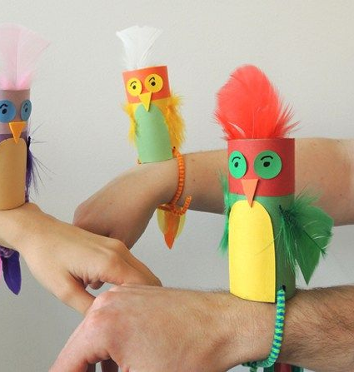
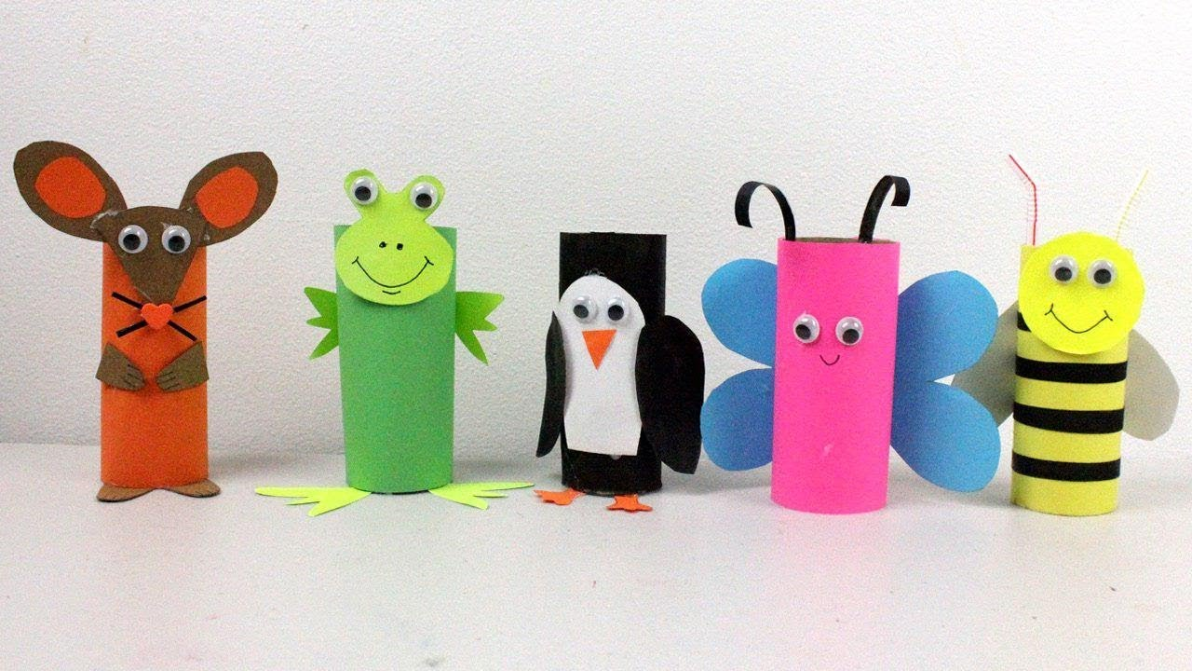
Make loo roll animals and put on a puppet show.

Slide 13
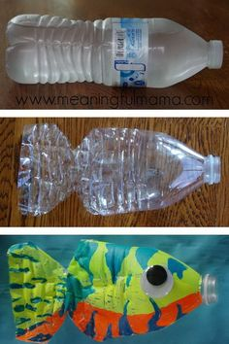
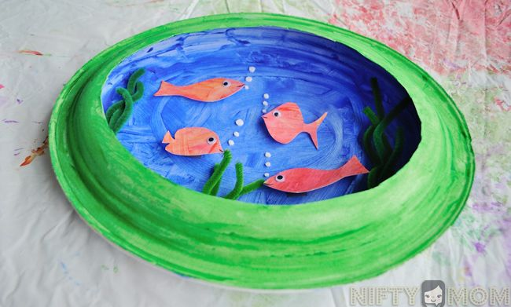
Make an indoor pond -bowl of water, cut fish etc. out of plastic milk cartons.

Slide 14
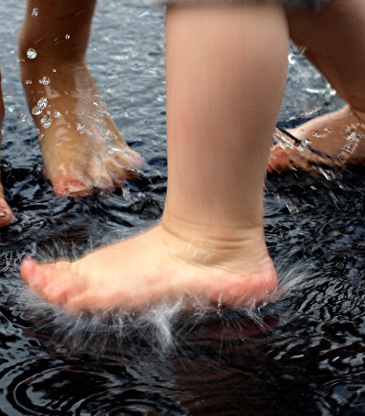
Splash feet in water while listening to ocean sounds
http://www.youtube.com/watch?v=AFWvD5AYk_A

Slide 15
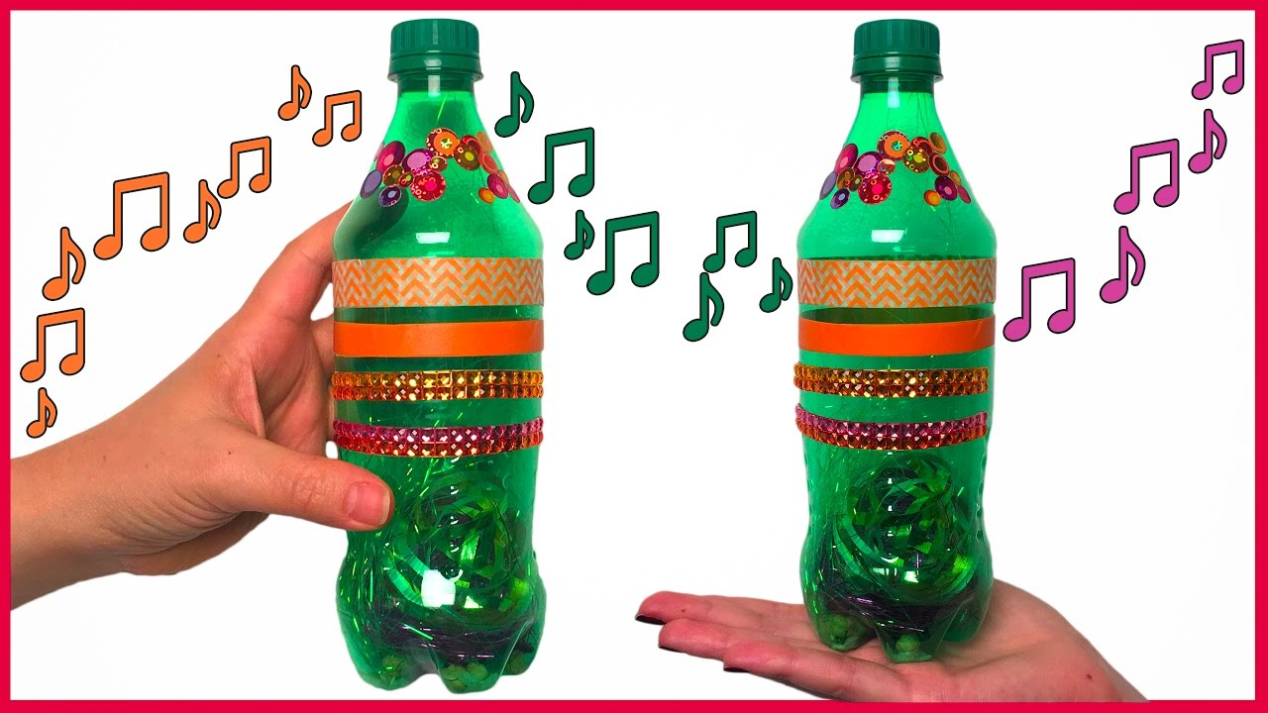
Make bottle shakers -fill with small nature objects to create different sounds -e.g. sticks, pebbles, water, leaves.

Slide 16
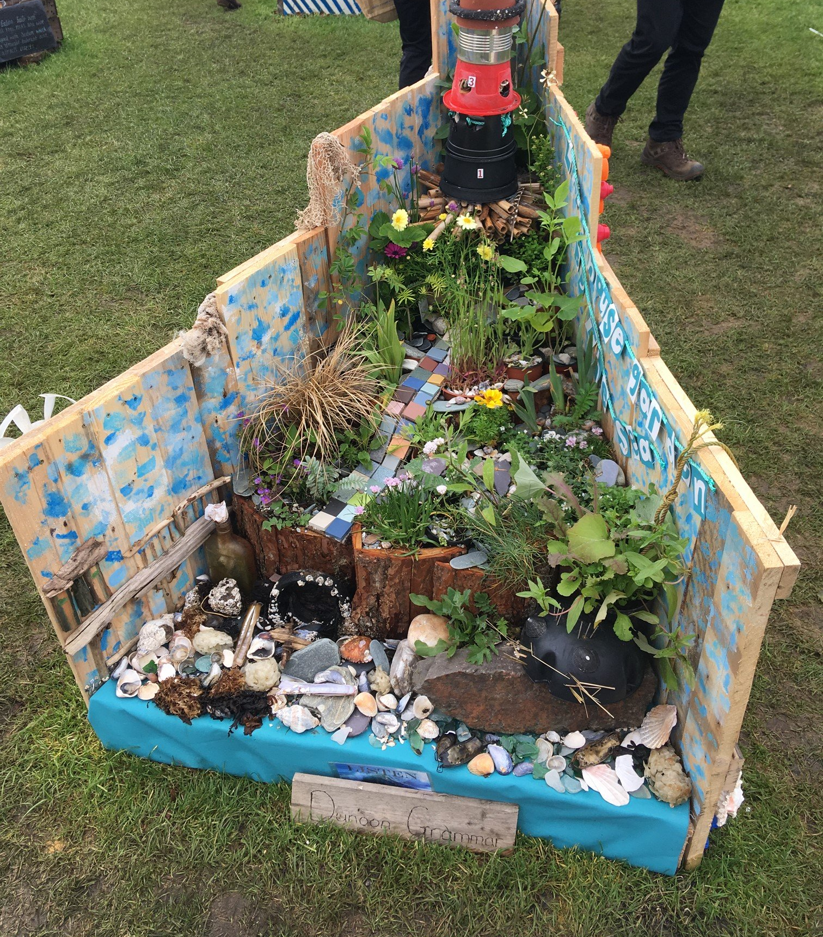
Make a pocket garden linked to Keep Scotland Beautiful competition.
https://www.keepscotlandbeautiful.org/sustainable-development-education/food-and-the-environment/pocket-garden/pop-up-pocket-gardens-at-home/

Slide 17
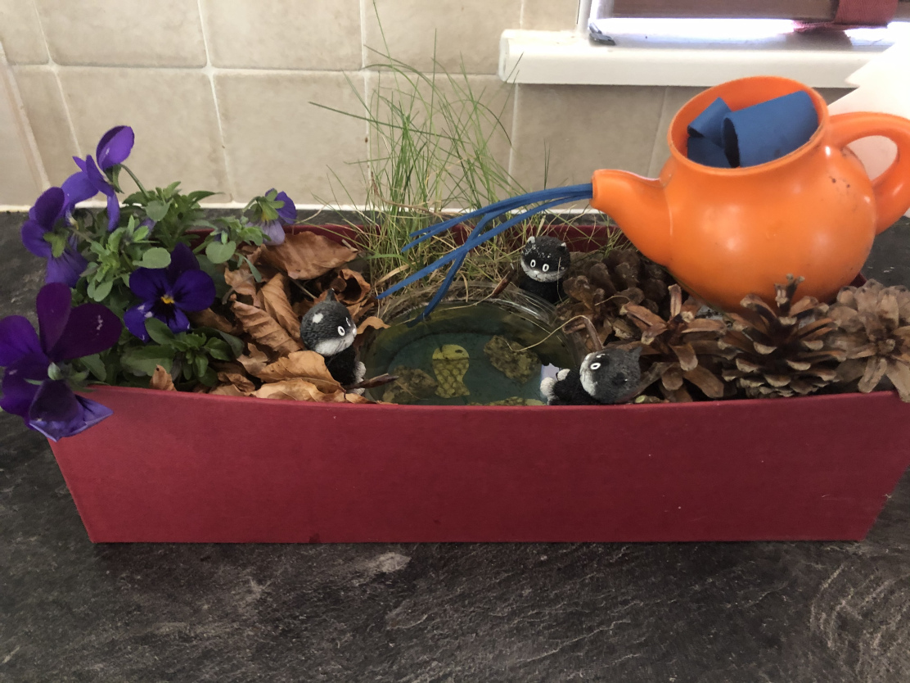
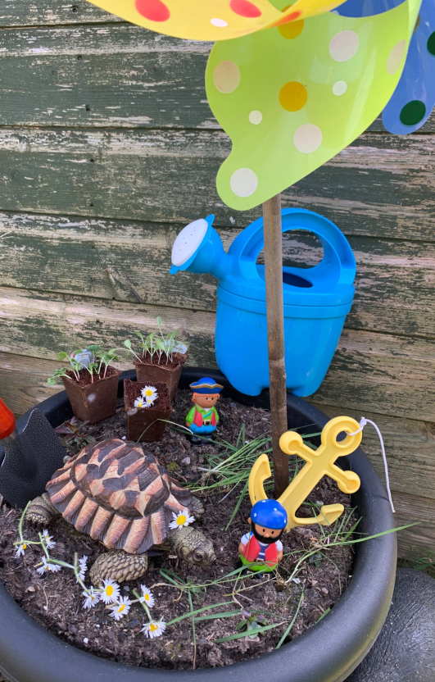
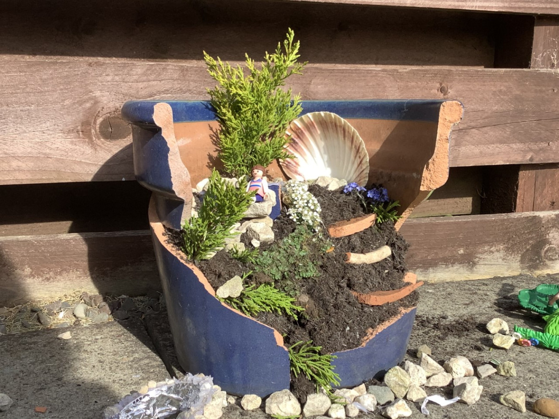
Some more simple, pocket garden ideas.

Slide 18
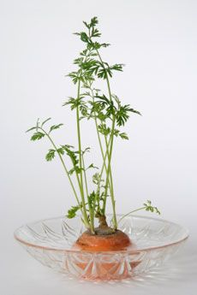
Grow some carrot or onion or parsnip tops in a saucer of water, they should start sprouting more leaves. Old potatoes will start sprouting too if kept in the light.

Slide 19
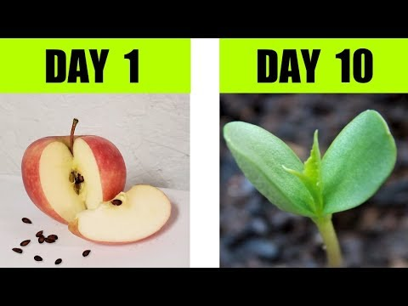
Cut open a tomato or apple or pear etc. to find the seeds and pop them in some compost or cotton wool, keep them watered and see if they’ll start to sprout.

Slide 20
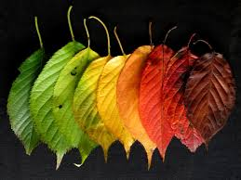
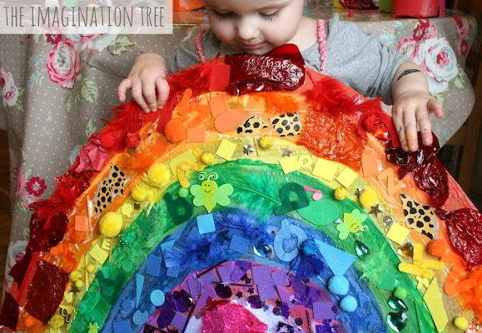
Make a rainbow: collect rainbow coloured clothes and peg them on a washing line, or make a collage from bits and pieces of paper or cardboard, cloths or old magazines around the house or use different coloured leaves, plants, petals.

Slide 21
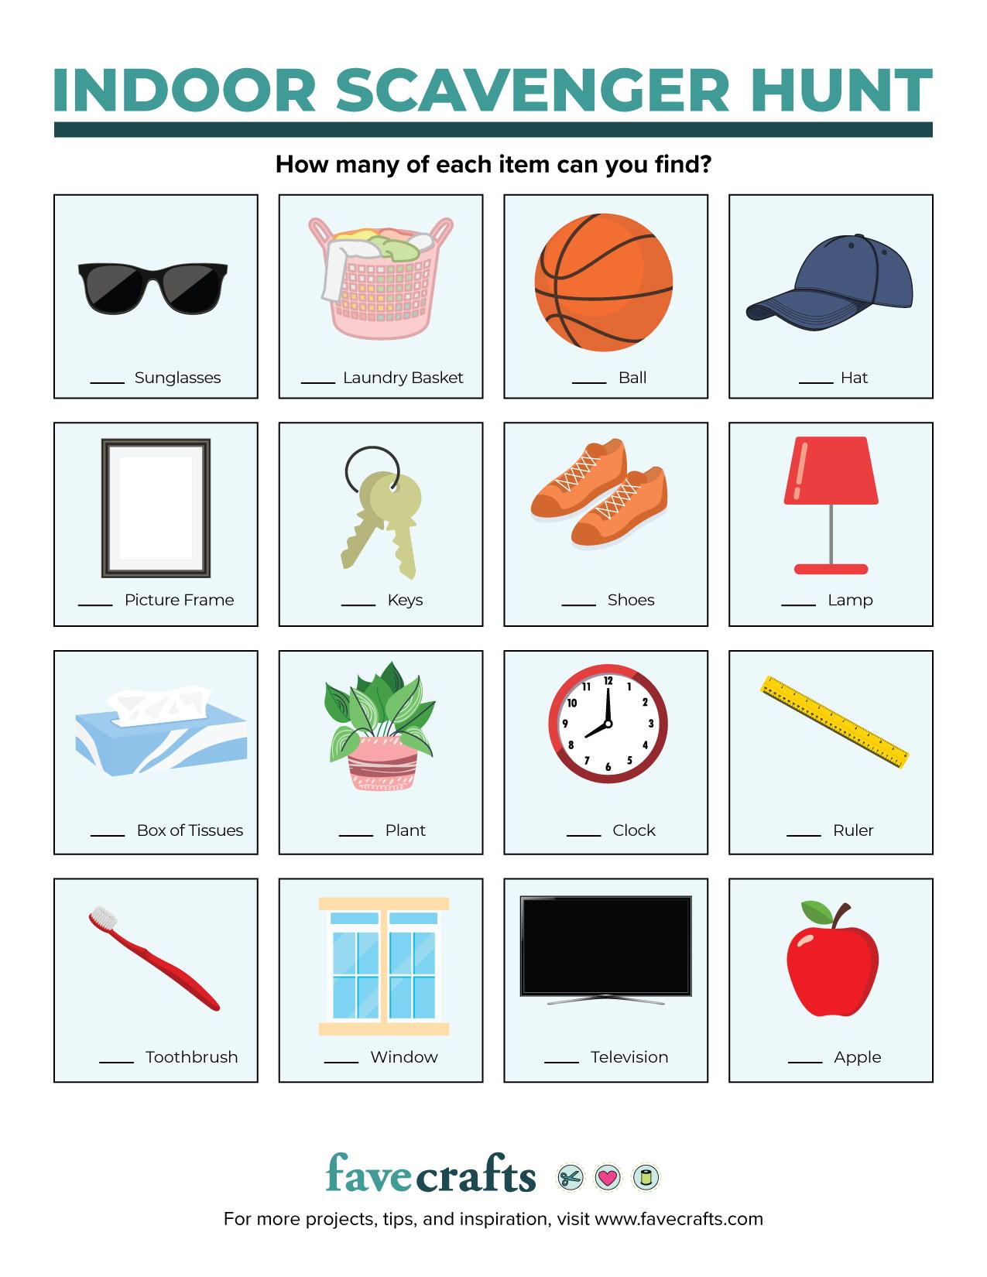
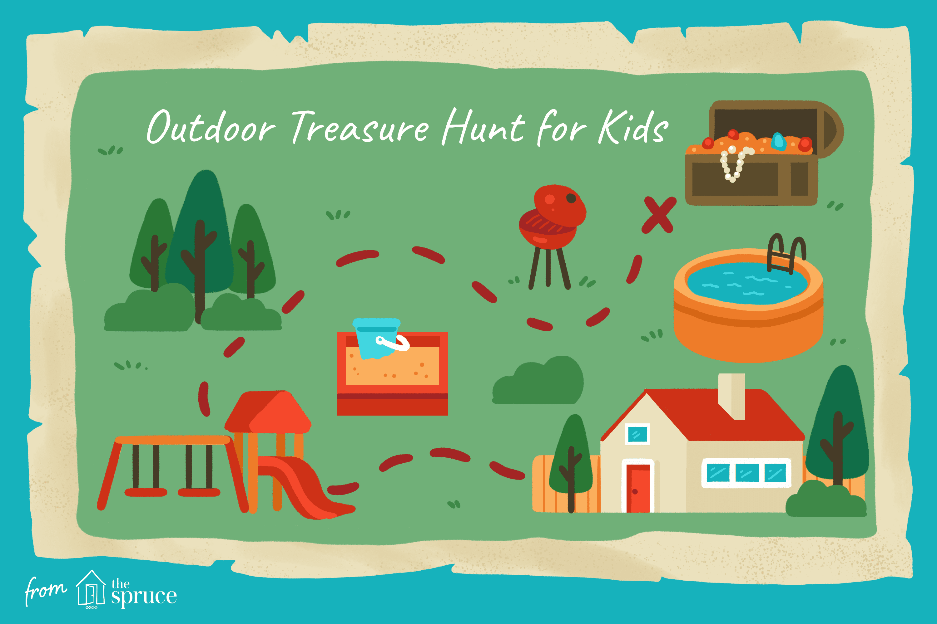
Go on a treasure hunt looking for things outside or inside-they could be natural or pre hidden in your garden/house or just different colours.

Slide 22

Sit outside together or open the window and listen to the sounds together…..... feel the breeze……........... and breathe…
…but most of all have just have fun…

