Slide 1
Growing Seeds

Slide 2
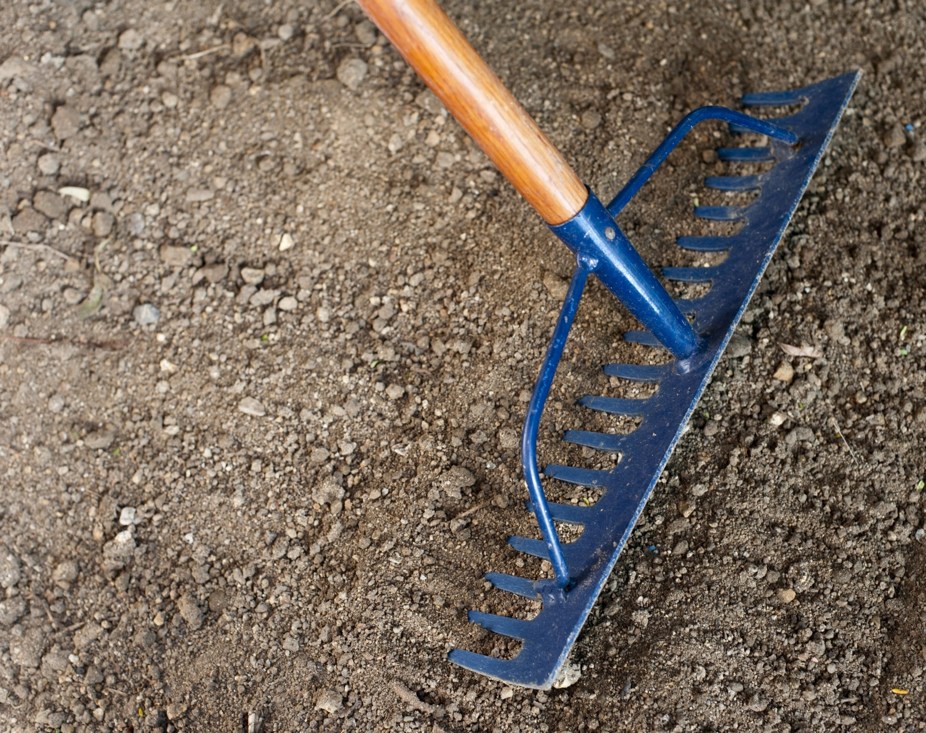
Out in the garden it is time to rake the soil. We need to make a soft bed for our seeds.
Stretch out child’s arms, palms down and fingers like claws. As arms are drawn back say, “Raaaaaaaaaaake.” Repeat x 5

Slide 3
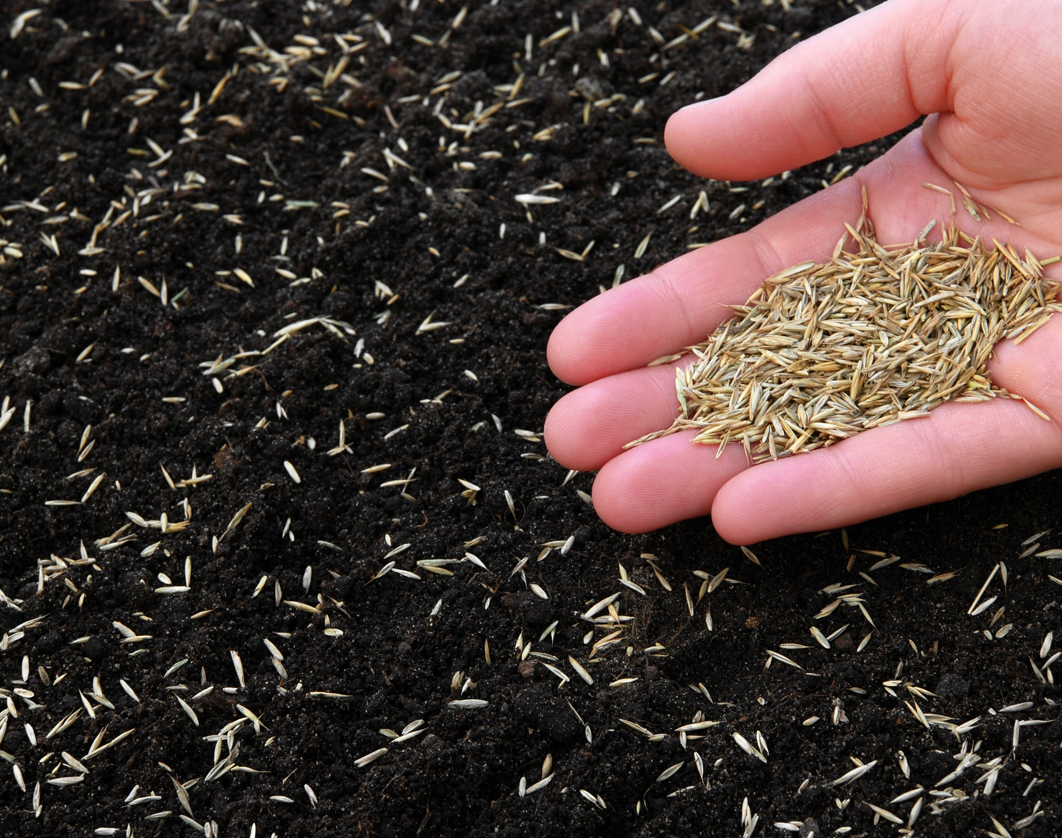
We open our packet of seeds and sprinkle them onto the soil.
Use dried seeds(or lentils, rice etc) and drop a pinch onto a plate or tray. Listen to the sounds they make.

Slide 4
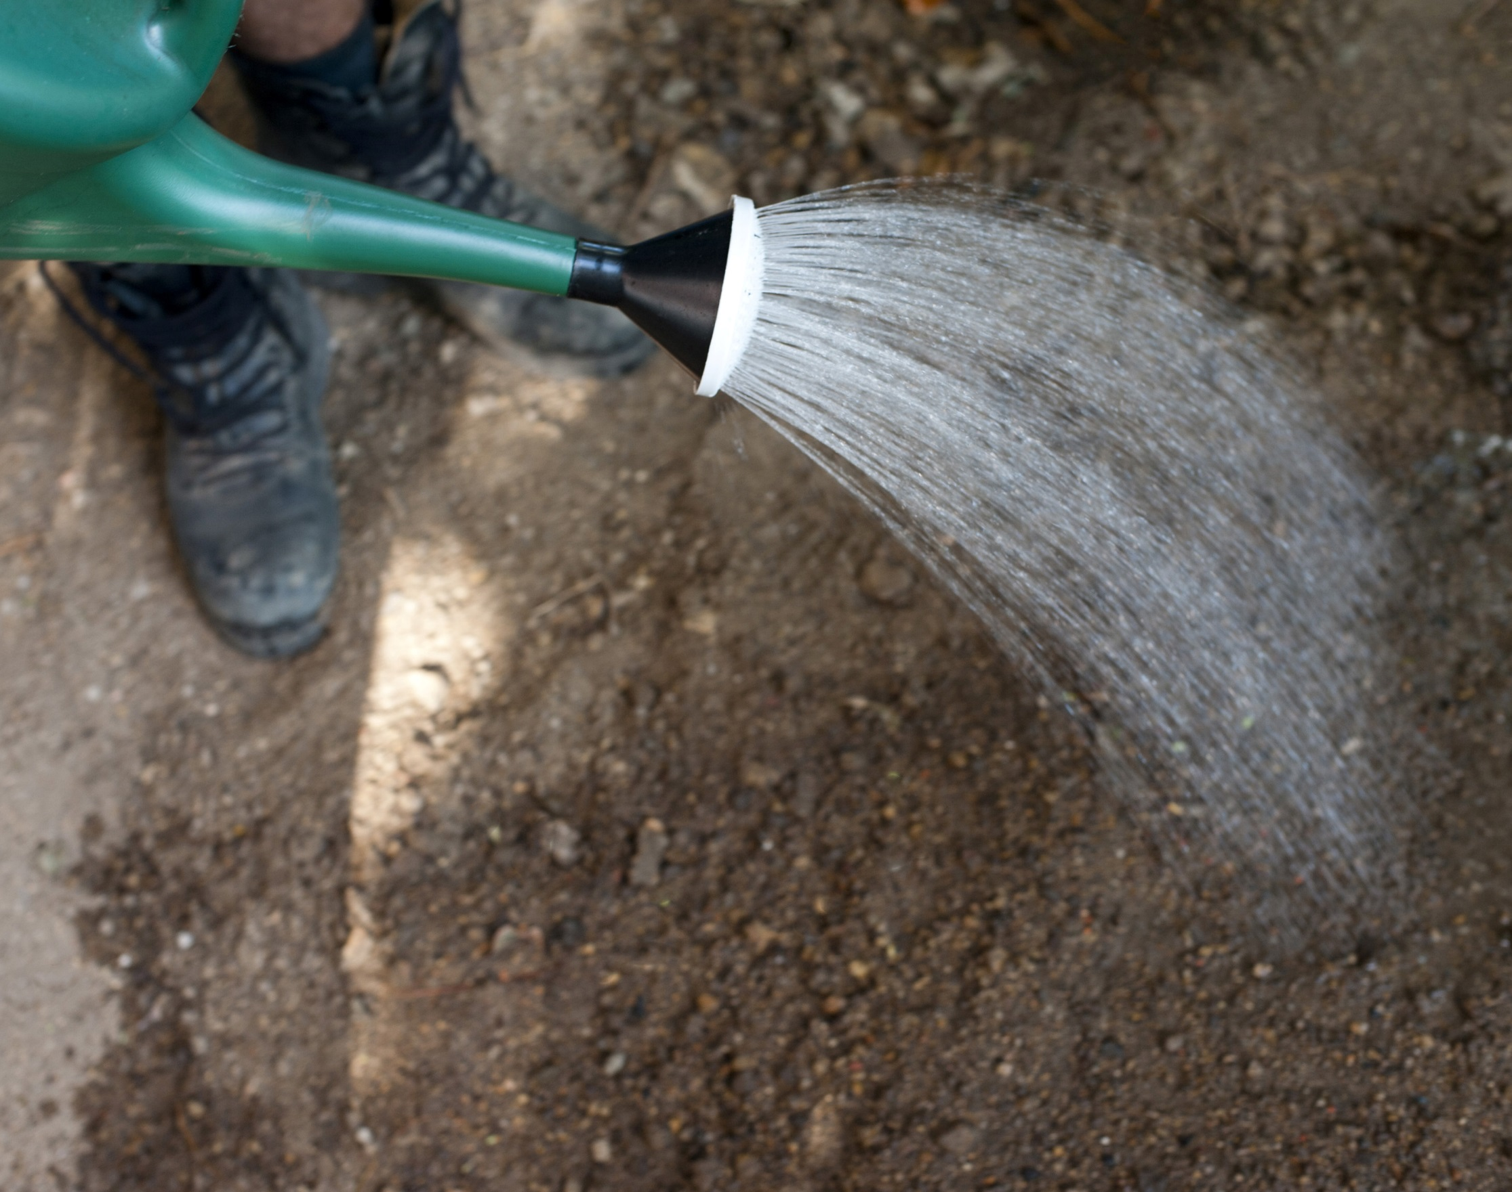
We cover the seeds with a little soil and then give them some water.
Use your fingers to pitter patter like water drops up and down child’s arms, legs, head etc.

Slide 5

Now we leave the seeds for nature to look after.
The sun comes out and warms them up.
Use a frying pan and gently run a wooden spoon around the inside to make a gentle cyclical sound.

Slide 6
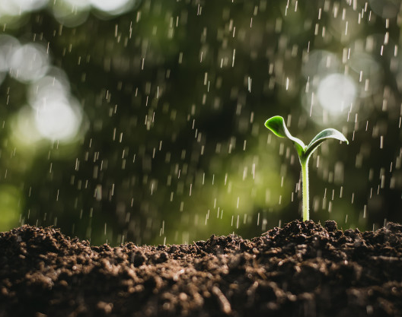
The rain falls down and gives our seeds a drink.
Repeat pitter patter action with finger tips.

Slide 7
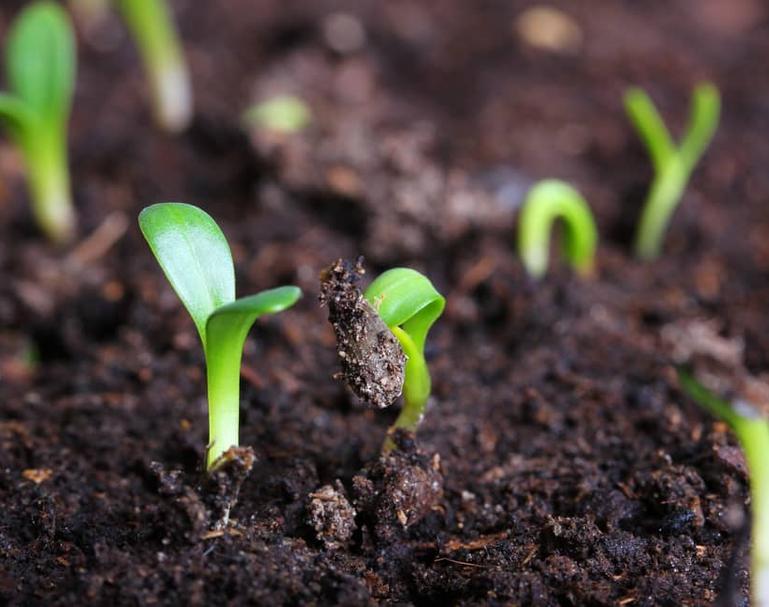
Very soon our seeds begin to grow. They get taller and leaves start to appear.
Clasp child’s hands together and move them from side to side as you raise them up.

Slide 8
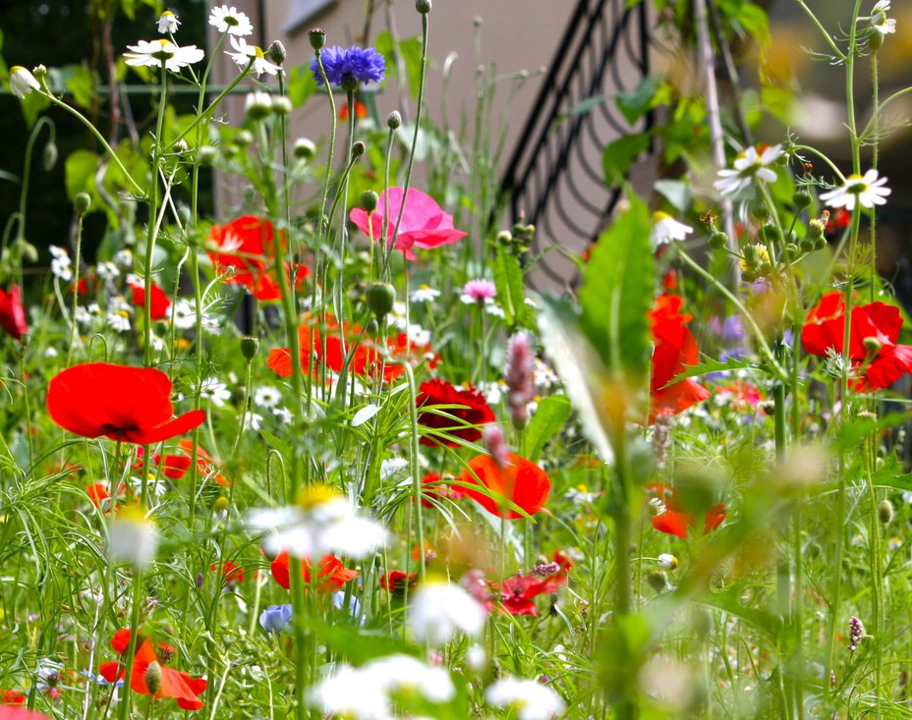
Flower buds soon appear and then before we know it the buds burst open. Our garden is filled with beautiful flowers.
Close your fists and burst them open into flowers shapes close to your child with a “Pfffffff” noise. If you have silky scarves of different colours you could wave these around t represent the flowers too

Slide 9

The Little Cherry Seed

