Slide 1
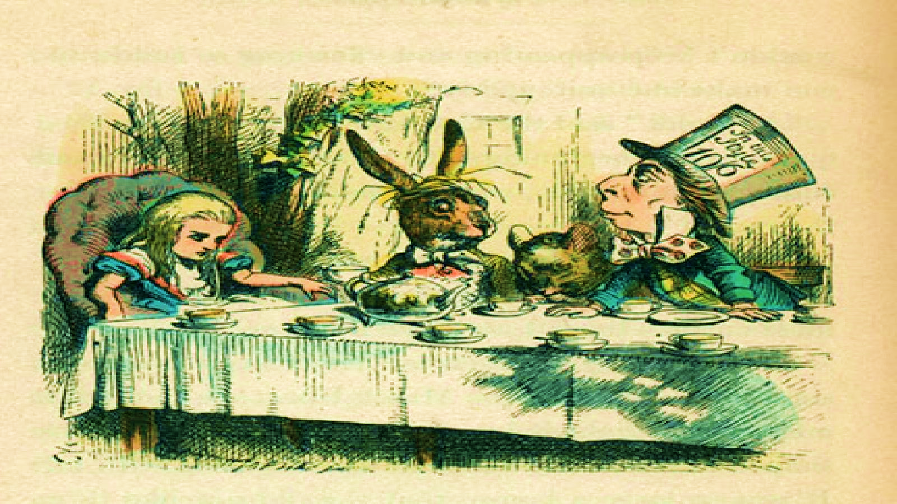
Alice in Wonderland – The Tea Party Massage

Slide 2
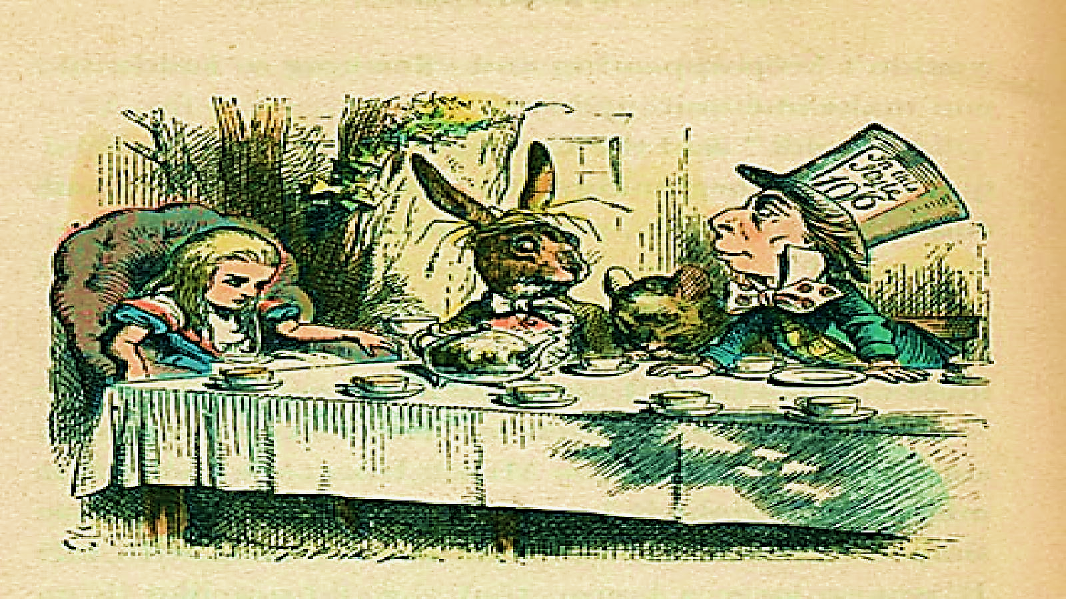
What is Story Massage?
Story Massage involves the use of simple movements on the body, associated with words that help to build up a story. Tracing a large circle on a child’s back, for example, can depict the image of the world while a gentle squeezing action on the shoulders can represent eating something very delicious.

Slide 3

What do I need?
All you need is this power point and your hands.
Optional: You could use oil such as rapeseed oil or a scented cream to massage, but this is optional and will depend on your child’s preferences. It may be more calming and relaxing for your child to have the lights off or dimmed during this activity (e.g. turn the main light off and use a lamp).

Slide 4
What to do?
Move through the slides one at a time. Read the instructions and then click the audio link.
Read the words in the ‘read aloud’ box at the beginning of each song
Perform the movement on your child as suggested in the ‘Massage movement’ column for the duration of the song.

Slide 5
What are the benefits?
There are numerous benefits for children of all ages and abilities. These are just some of the benefits:
Improved calmness and concentration
Increased self-awareness
Develop a sense of anticipation
Provide opportunity to communicate preferences

Slide 6
Let the massage begin!

Slide 7
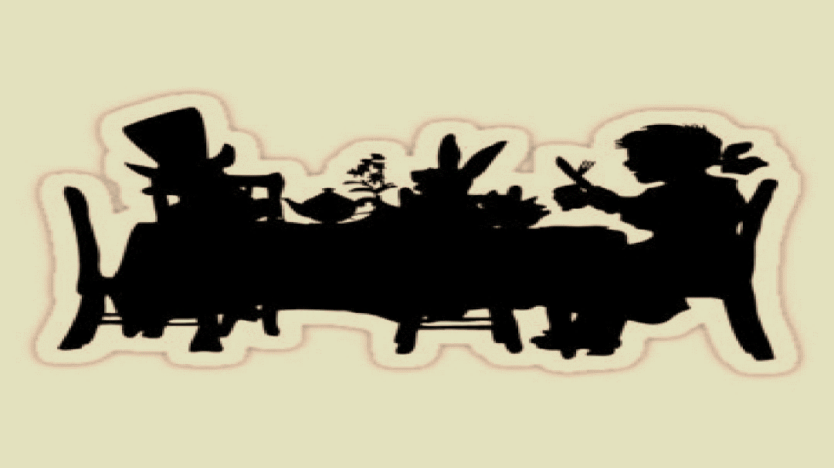

Say: Sleepy Alice – wake up!
The Squeeze
Place both hands on the shoulders, gently squeeze, and release. Work down the arms and back up, squeezing the hands as well when you get there. Move to the lower legs, squeeze up and down the calves.

Slide 8
Say: Look- Rabbit! Follow!
The Sprinkle
With both hands working at the same time, lightly tap the pads of your fingers, one finger at a time, in a random fashion all over the back, or other area, as if playing piano.

Slide 9
Say: A tea party – I’m coming!
The fan
Rest your hands flat on either side of the spine at the base of the back. Stroke hands upwards and outwards ‘fanning out’ and finishing at the shoulders. Alternatively brush your hands outwards from the collar bone to the front of the shoulders. After a while, you can change to brushing down their arms and then legs in large sweeping motions with your hands.

Slide 10
Say: Food fight!
The Swish
Use a thin scarf or other fine fabric and swish it across their body, face and head. Alternatively, use a fan to fan them.

Slide 11
Say: Here comes the Queen
– off with their heads!
The drum
With both hands held in loosely clenched fists and with hands moving one after the other, gently ‘drum’ all over.

Slide 12
Say: Time to go – follow that rabbit!
The Spiral
Begin with your index finger in the middle of the back, or other area such as hands or feet, and gently trace a spiral outwards and then reverse inwards again repeatedly.

Slide 13
Say: I’m full – let’s rest.
The Head & Face Rub
Use your fingers to make small sweeping movements from the middle of the eyebrows out to the hairline, repeating as you cover the whole forehead.
Next sweep down with the fingers of both hands from the bridge of the nose and out across the cheekbones. You could repeat these above the top lip and on the chin
Next make small circles on from the cheekbones down along the jaw, with the circles moving up and back to start.
Finally, move to the top and back of the head, using your fingers to massage in a circular movement.

Slide 14
Say: Shake hands – goodbye.
The goodbye
Use one hand to support back of pupil’s hand or behind heel of foot. Use other hand to gently rub down from palm/heel to fingers/toes.

Slide 15
Thank your partner for joining you for massage.

